Slide 1

Vue Js
A Frontend JavaScript framework

Slide 2
Group Members:
Muhammad Saad Hassan
Mubshir Yasin
Ali Ghulam

Slide 3
What is Vue.js?
Vue.js is a library for building interactive web interfaces.
Focused on the view layer
Easily integrate with other libraries
Current version: 2.4.1
It follows MVVM (model-view-viewmodel) architectural pattern.

Slide 4
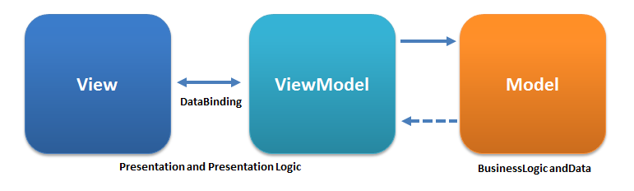
MVVM Pattern
Model–view–viewmodel (MVVM) is a software architectural pattern that facilitates the separation of the development of the graphical user interface (the view) – be it via a markup language or GUI code – from the development of the business logic or back-end logic (the model) so that the view is not dependent on any specific model platform. The view model of MVVM is a value converter, meaning the view model is responsible for exposing (converting) the data objects from the model in such a way that objects are easily managed and presented. In this respect, the view model is more model than view, and handles most if not all of the view's display logic. The view model may implement a mediator pattern, organizing access to the back-end logic around the set of use cases supported by the view.

Slide 5
Key features
Simple(low barrier of entry)
Lightweight (~24kb min+gzip)
Fast
Reactive
Component based

Slide 6
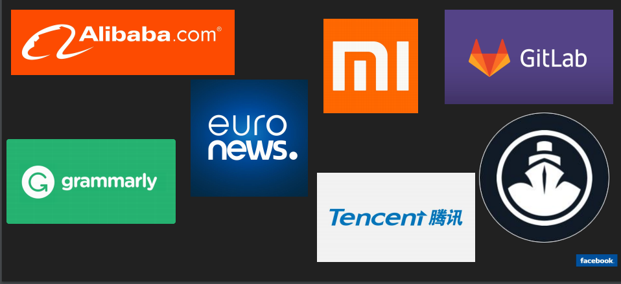
Company which use

Slide 7
Installing
CDN (Content Delivery Network)
NPM (Node Package Manager)
Bower
CLI (Command Line Interface)

Slide 8
Ecosystem
Ajax
Routing
Flux-like State
CLI Generator
Linting
...

Slide 9
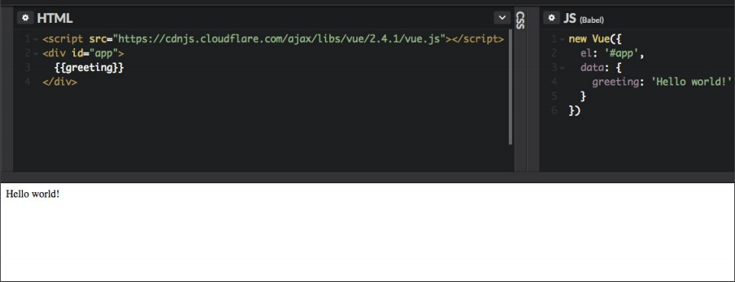
Vue Instance
The Vue instance is the root of every Vue application(interface).
The Vue instance plugs into an element in the DOM.
The Vue instance’s data can be displayed using {{ }} called an expression.
Vue is reactive.

Slide 10
Vue Directives
v-text
v-html
v-show
v-if
v-else
v-else-if
v-for
v-on
v-bind
v-model
v-pre
v-cloak
v-once

Slide 11
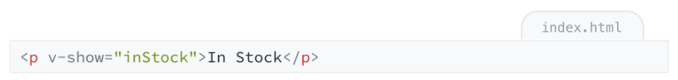
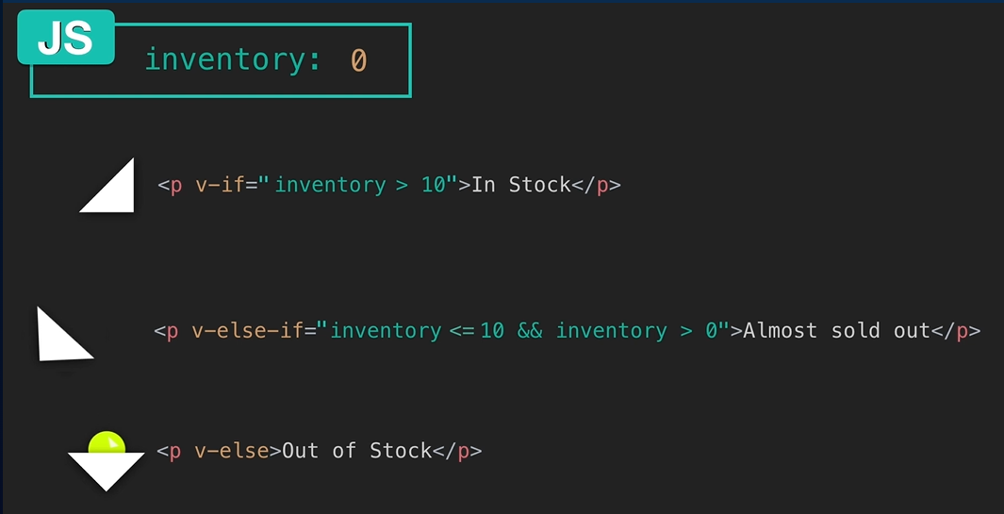
Conditional Rendering
There are Vue directives to conditionally render elements:
v-if
v-else-if
v-else
v-show
If whatever is inside the directive’s quotes is truthy, the element will display.
You can use expressions inside the directive’s quotes.
V-show only toggles visibility, it does not insert or remove the element from the DOM.

Slide 12
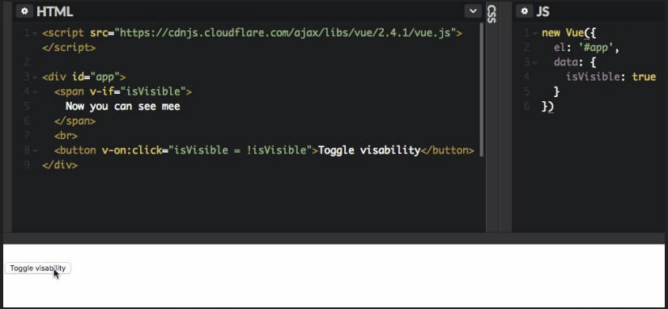
v-if

Slide 13
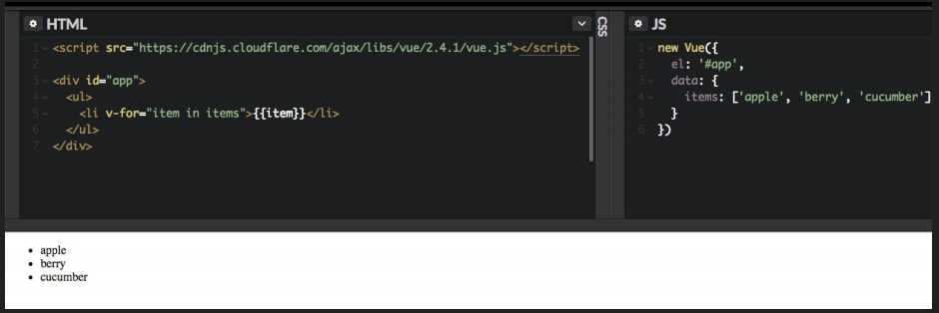
v-for

Slide 14
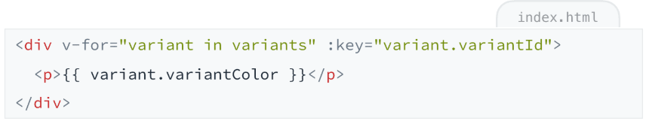
v-for
The v-for directive allows us to iterate over an array to display data.
We use an alias for the element in the array being iterated on, and specify the name of the array we are looping through. Ex: v-for="item in items“
We can loop over an array of objects and use dot notation to display values from the objects.
When using v-for it is recommended to give each rendered element its own unique key.

Slide 15
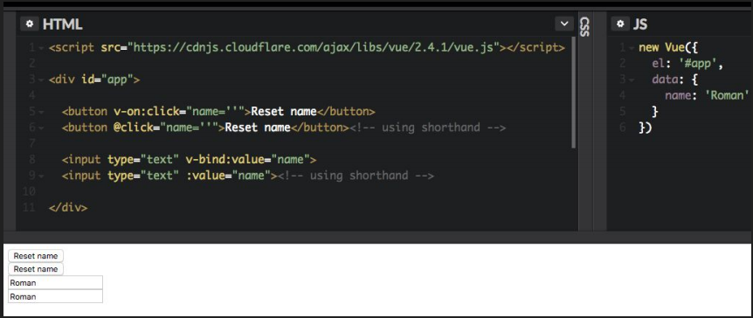
v-bind / v-on

Slide 16
v-bind / v-on
The v-on directive is used to allow elements to listen for events
The shorthand for v-on is @ (using ES6 Syntax)
The v-on directive is used to bound data to HTML attributes
Syntax is v-bind: or : for short (using ES6 Syntax)
The attribute name that comes after the : specifies the attribute we’re binding data to.
Inside the attribute’s quotes, we reference the data we’re binding to.

Slide 17
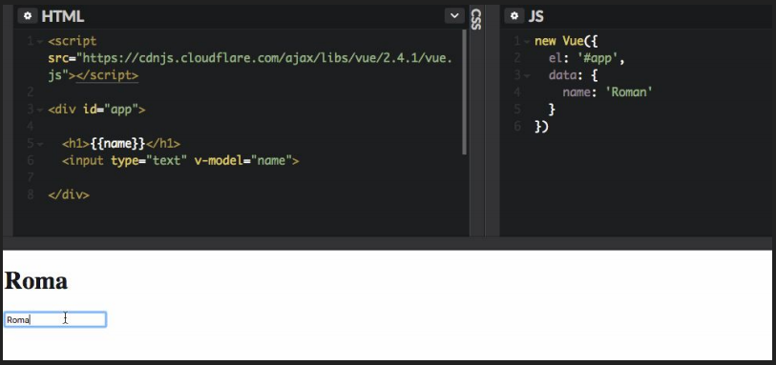
v-model

Slide 18
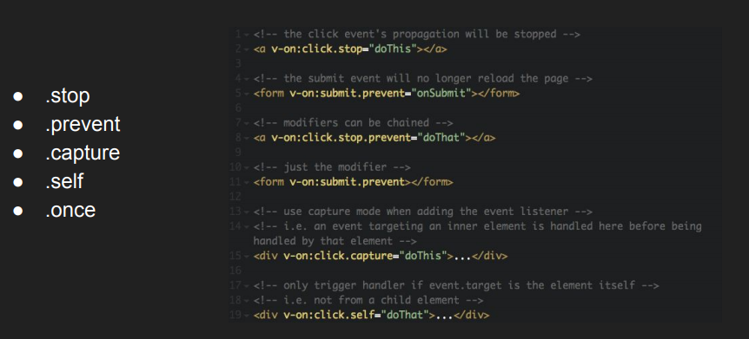
Event modifiers

Slide 19
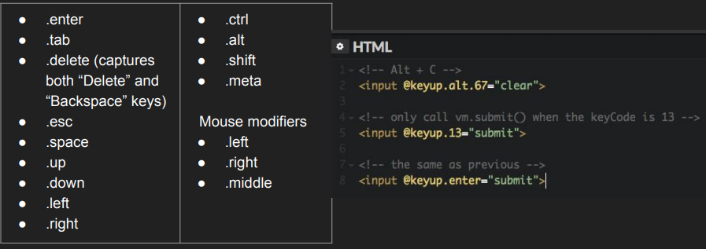
Keys modifiers

Slide 20
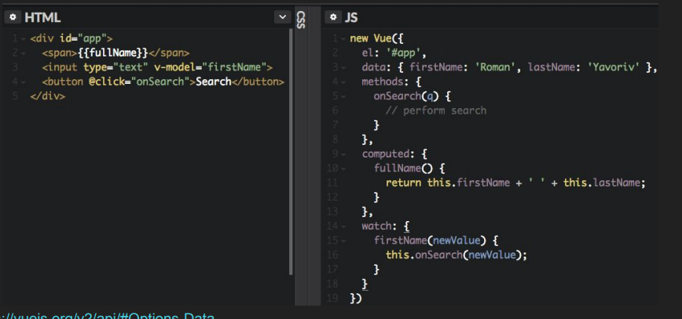
Vue instance properties

Slide 21
Components
Components are blocks of code, grouped together within a custom element
Components make applications more manageable by breaking up the whole into reusuable parts that have their own structure and behavior
Data on a component must be a function
Props are used to pass data from parent to child
We can specify requirements for the props a component is receiving
Props are fed into a component through a custom attribute
Props can be dynamically bound to the parent’s data
Vue dev tools provide helpful insight about your components

Slide 22
Pros
Very Small Size. The success of JavaScript framework depends on its size
Easy to Understand and Develop Applications. Simplicity is part of Vue's DNA
Vue is known for its Flexibility.
Good Detailed Documentation.
Addresses the Drawbacks of AngularJS and ReactJS.

Slide 23
Cons
Relatively small community
Is not backed by giant company
Relatively small amount of resources

Slide 24
Vue Project Live demo
Project Name: StreamCart
Its simply a Ecommerce website for buying Gamming products.
We can add products we like to:
Add to Cart
Add to Wishlist
For Customer there are:
Sign up form
Sign in form
Let’s take a live demo.

